Slide 1
APA Workshop
Perspectives on Information, Fall 2024

Slide 2
Workshop Objectives
Understand the essentials of APA format (7th edition).
Learn how to properly format key elements: title pages, in-text citations, and references.
Identify common APA formatting mistakes and how to avoid them.

Slide 3
Introduction to APA Format
Welcome & Objectives
Greeting: Welcome everyone. Today we are going to be giving a workshop on APA formatting crafted from a combination of a workshop by Owl Purdue, our friend Chat GPT, and our collective experience using APA to help set you up for success with your assignments in this course.

Slide 4
Introduction to APA Format
What is APA Format?
Definition and Purpose: APA format is a set of guidelines developed by the American Psychological Association, primarily used in the social sciences such as Psychology, Linguistics, Sociology, Economics, and Criminology, Business and Nursing. Its purpose is to standardize the presentation of research papers to ensure clarity and uniformity across publications.

Slide 5
Introduction to APA Format
Why use APA?
Provide readers with cues they can use to follow your ideas more efficiently and to locate information of interest to them
Allow readers to focus more on your ideas by not distracting them with unfamiliar formatting
Establish your credibility or ethos in the field by demonstrating an awareness of your audience and their needs as fellow researchers
WE WANT TO SEE THAT YOU CAN
Notes:
At this point in your education, regardless of whether you continue to use APA or not, it is important that you are able to understand and follow direction given to you by an instructor. We want to see that you can implement what you have been taught

Slide 6
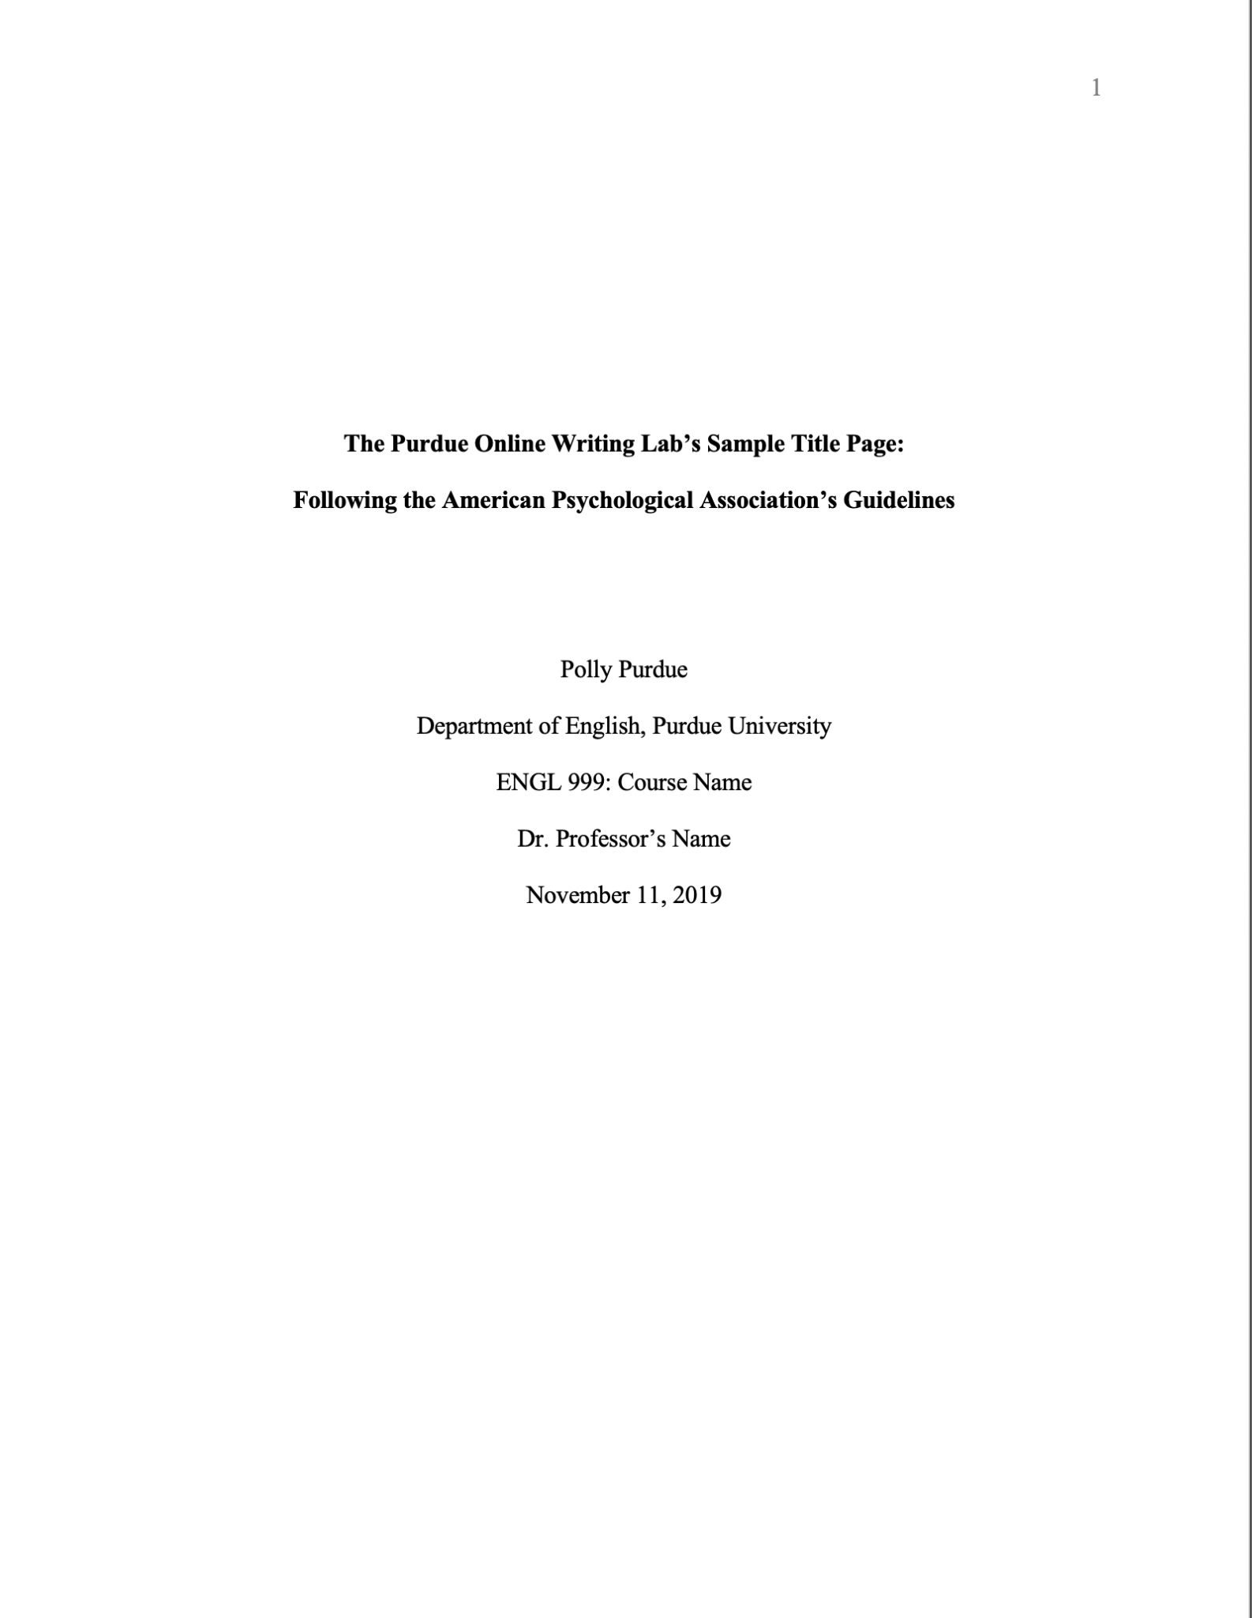
Core Paper Structure: Title Page
Elements of a Title Page (for student papers):
Title of the paper: Bold, centered, and positioned in the upper half of the page.
Author’s name(s): Centered below the title.
Institutional affiliation: Centered below the author’s name(s).
Course name and number, instructor’s name, and due date: Included on student title pages.
Page number: Appears in the top right corner.

Slide 7
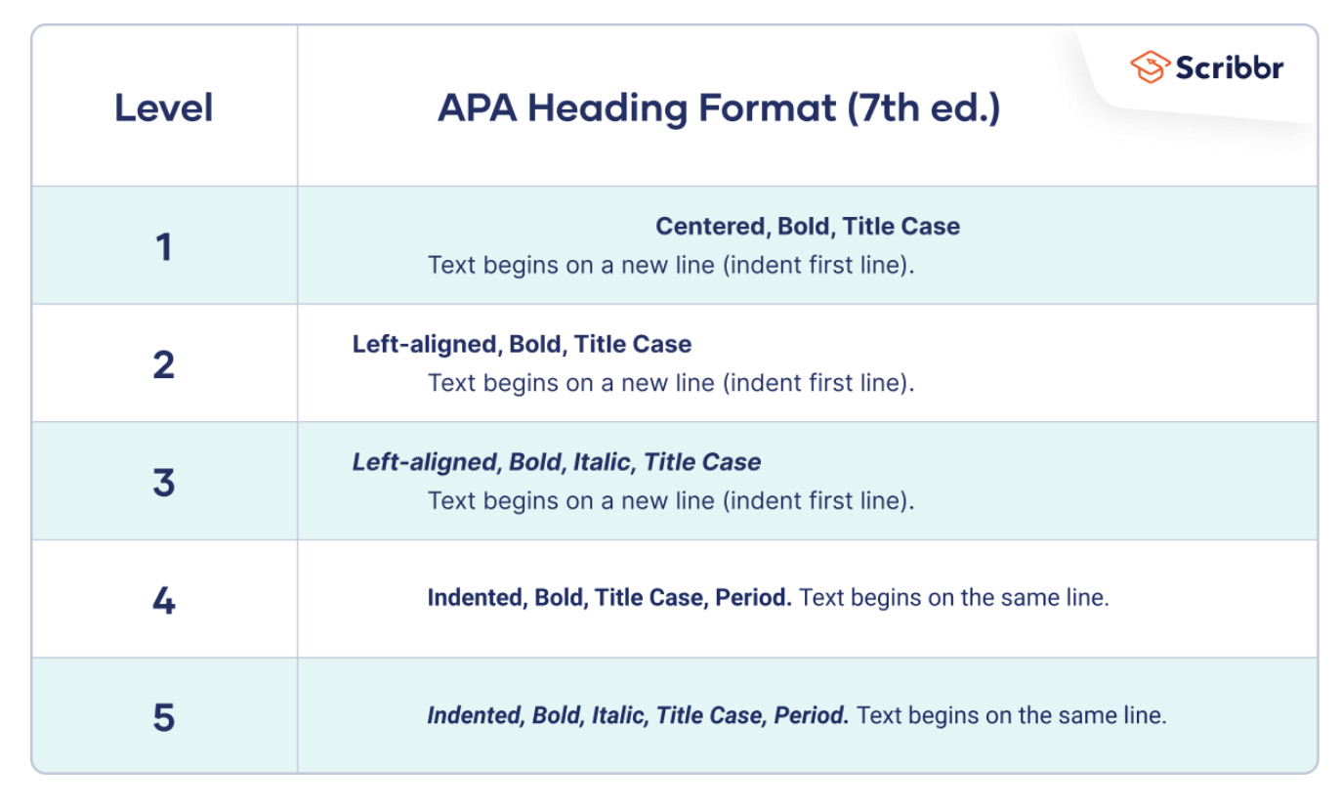
Core Paper Structure: Main Body
Formatting Guidelines:
Font: While the APA Manual does not specify a single font or set of fonts for professional writing, it does recommend a few fonts that are widely available. These include sans serif fonts such as 11-point Calibri, 11-point Arial, and 10-point Lucida Sans Unicode as well as serif fonts such as 12-point Times New Roman, 11-point Georgia, 10-point Computer Modern.
Spacing: Double-space all text.
Margins: Use 1-inch margins on all sides.
Headings and Subheadings:
Level 1: Centered, bold, Title Case Heading.
Level 2: Flush Left, Bold, Title Case Heading.
Level 3: Flush Left, Bold Italic, Title Case Heading.
Level 4: Indented, Bold, Title Case Heading, ending with a period. Text begins on the same line.
Level 5: Indented, Bold Italic, Title Case Heading, ending with a period. Text begins on the same line.

Slide 8
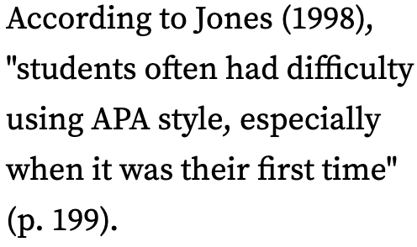
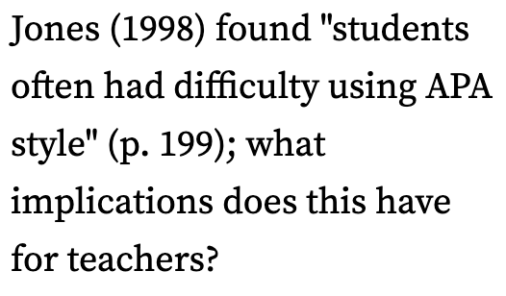
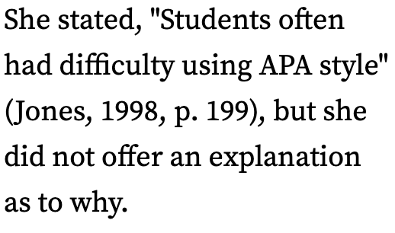
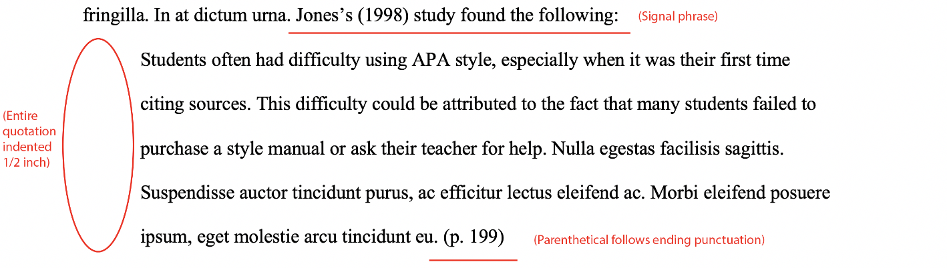
Core Paper Structure: In-Text Citations
Parenthetical vs. Narrative Citations:
Parenthetical: Place both the author’s last name and the publication year in parentheses, e.g., (Smith, 2020).
Narrative: Incorporate the author’s name into the text, followed by the year in parentheses, e.g., Smith (2020) states that...
Direct Quotes vs. Paraphrasing:
Direct Quote: Include the page number, e.g., (Smith, 2020, p. 23).
Long Direct Quote (over 40 words): Free-standing block of typewritten lines, omit quotation marks and parenthetical citation comes after closing punctuation mark.
Paraphrasing: No page number is needed, e.g., (Smith, 2020).
Citing Multiple Authors:
Two Authors: Always list both names with an & e.g., (Smith & Johnson, 2020) OR if it is narrative, “Smith and Johnson (2020) decided that…”
Three or More Authors: Use "et al." after the first author’s name for all citations, e.g., (Smith et al., 2020).
Notes:
Include examples of citing a short quote vs. a long quote (over 40 words)

Slide 9
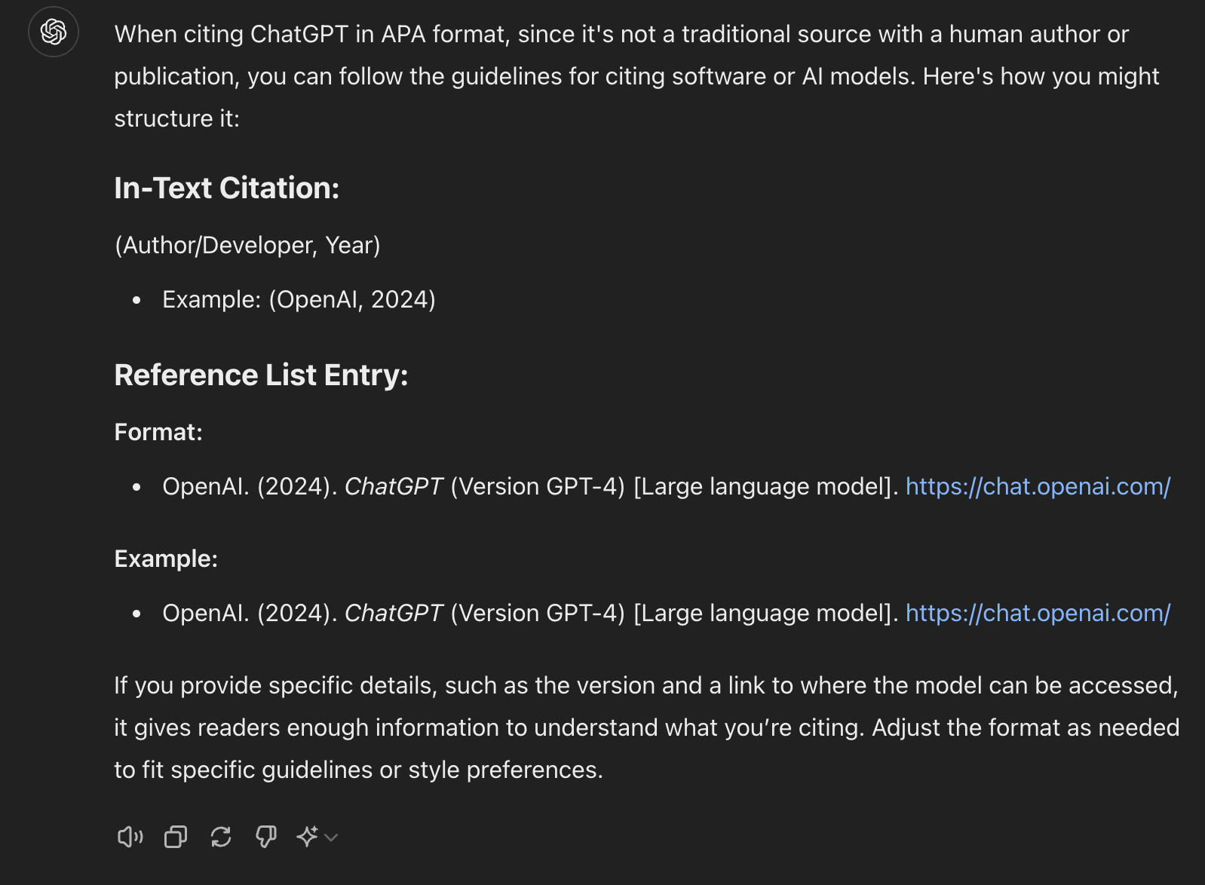
Core Paper Structure: In-Text Citations (cont.)
Citing Common Sources
Books: (Author, Year) e.g., (Smith, 2020).
Journal Articles: (Author, Year) e.g., (Smith, 2020).
Websites: Include the author (if available) and year, e.g., (Smith, 2020).
But y’all, what about citing A.I?
Notes:
Which leads us right into our next and last section, which is references.

Slide 10

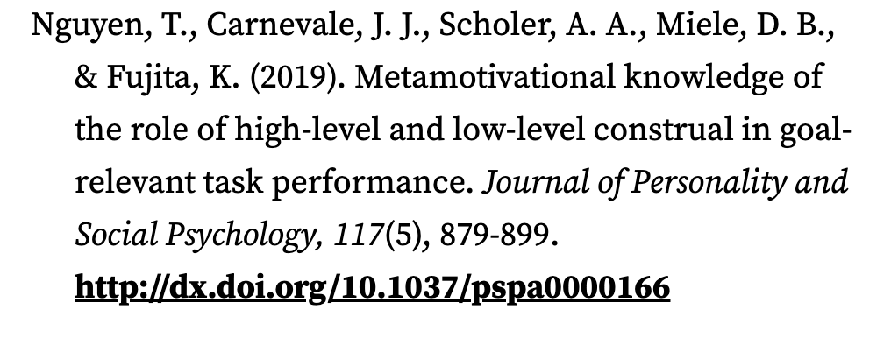
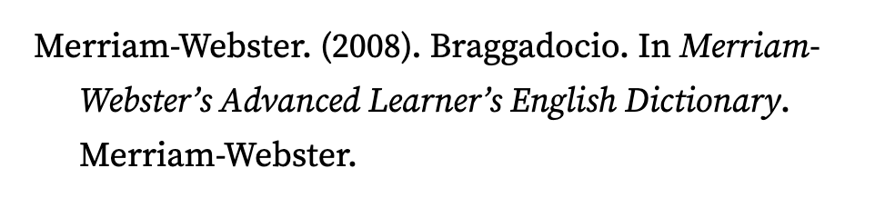
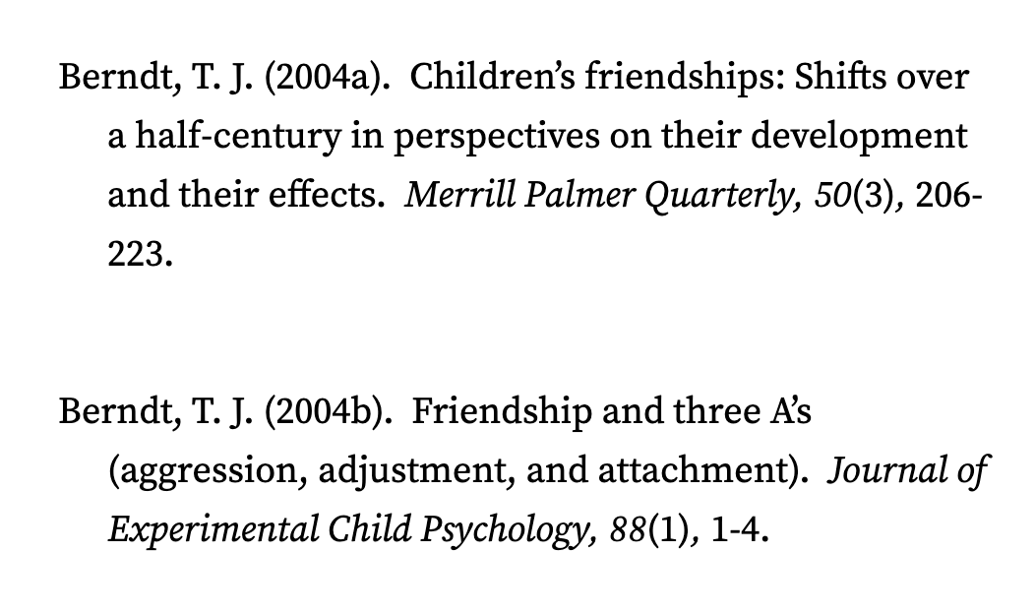
Core Paper Structure: References
General Reference List Formatting:
Title: "References" should be centered and bolded at the top of a new page.
Author Names: Authors' first and middle names should be written as initials. For example, the reference entry for a source written by Jane Marie Smith would begin with "Smith, J. M."
Order: Entries should be alphabetized by the surname of the first author.
Hanging Indent: Each reference should have a hanging indent (first line flush left, subsequent lines indented).
Formatting Different References
Books: Author, A. A. (Year). Title of work: Capital letter also for subtitle. Publisher.
Journal Articles: Author, A. A. (Year). Title of article. Title of Periodical, volume number(issue number), pages. DOI/URL.
DOIs may not always be available. In these cases, use a URL.
Websites: Author, A. A. (Year, Month Day). Title of web page. Site Name. URL
Notes:
What are each of these examples of? (book, journal, website, two works by the same author the same year)

Slide 11
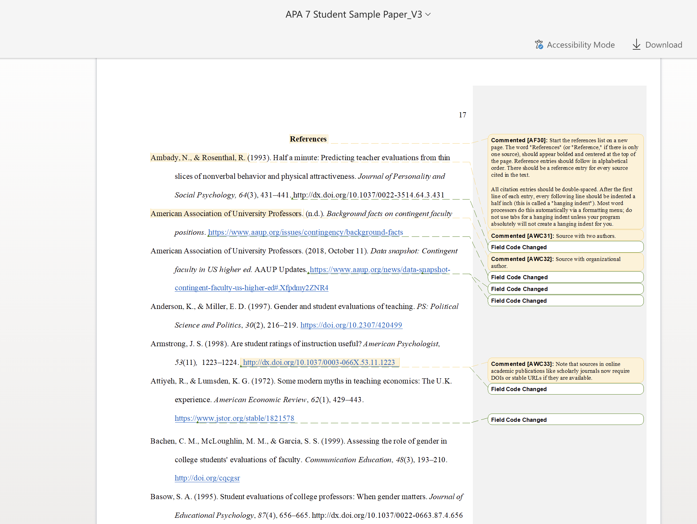
Core Paper Structure: References (cont.)

Slide 12
Quick Tips and Q&A
Common Mistakes to Avoid:
Missing citations (e.g. not citing a source quoted or referenced).
Incorrectly formatted in-text citations (e.g. forgetting the comma between the author’s name and year).
DOI/URL (e.g. not including a link)
Improper use of “et al.” (e.g. using it for two authors).
Misformatted reference entries (e.g. missing DOI or incorrect use of italics).
Tips:
Proofread Carefully: Double-check citations and references for consistency and correctness.
Use Reference Management Tools: Tools like Zotero or EndNote or Google Scholar can streamline citation and reference list creation.
Check against this workshop and examples from Owl Purdue and APA Style Blog
Check using A.I.
Questions? Concerns?

Slide 13
Additional Resources
Links to Online Resources:
OWL Purdue:
APA Style (7th Edition) - Purdue OWL
Sample Student Paper
APA Overview and Workshop - Purdue OWL
APA Style Blog:
APA Style Blog
Academic Writer Tutorial: Basics of Seventh Edition APA Style - Overview

Slide 14
Thank you!

Slide 15
OUTLINE REFERENCES (extra)

Slide 16
APA Paper Outline Format Example
I. Introduction
A. What is a full-sentence outline?
1. Every point in a full sentence outline is one line
a. It means that every line is one complete sentence.
b. One sentence per line.
2. Full sentence outline is best suitable for essay or speech
a. It looks like an essay ora report
b. It enables you to see how your essay would look like
B. Why use an outline?
1. Helps you to organize your ideas
2. Presents your material in a logical manner
II. Body
A. Statement of the first main point
1. Support for the second main point
a. Support material for the main point, i.e., statistics, facts
b. More support if there is any
2. More support
a. Use supporting material
b. Use supporting material
B. Statement of the second main point
1. Support for the second point
a. Add supporting material
(1) If there are further points, add them under headings
b. Statistics, citations, facts
2. More support
III. Conclusion

Slide 17
Creating an Outline
An outline is a drafting tool to help you plan your paper. An outline provides structure for the sections and/or paragraphs of your paper, depending on the scope of your project. Please note that APA style does not require any specific formatting for outlines because APA style is intended for published texts and academic essays.
An outline should illustrate the progression of your thesis statement. Since each paragraph should have a main idea supported by evidence, you can use support from your research to outline your paper, paragraph by paragraph
A thesis statement is a short statement that introduces the argument of your paper as a whole.
Every paragraph in your paper should begin with a claim/main idea, which will be a debatable assertion or position that requires support. Claims build off one another in order to develop an argument over the course of an essay.
Every claim should be supported by evidence or support, the proof that validates your claim. Evidence and support usually come from other sources, like peer-reviewed journal articles. This can include facts, data, statistics, anecdotes, and more.
Keep the following tips in mind when creating an outline:
Remember, outlines should be helpful for you when writing your paper. You should be able to look at your outline and write major sections or paragraphs using the information and ideas in your outline.
Level 1 bullet points should outline the major topics and ideas of your paper.
Level 2 bullet points should plan out sub-topics, supporting ideas, and organizational aspects of your essay.
Level 3 bullet points illustrate an extra level of thought and detail in your outline that you might not need. However, if you have done a lot of research on your topic already, you can use Level 3 bullet points to plan out your analysis for each piece of evidence or where to address specific counterarguments.
It is not always required, but it can be a good idea to include a references page after your outline. This way, your sources are already organized when you begin drafting your essay.
Full sentence outlines are often accompanied with an APA reference list on a separate page. Quotes within the outline must also utilize APA in-text citations.

Slide 18
Sample Outline
https://csuglobal.libguides.com/ld.php?content_id=65296999

